Slide 1

Mass. Vehicle Crash Analysis
Shriram Karthikeyan & Abhinav Kaushik

Slide 2
Overview
To extract relevant data and build a model to produce a likelihood of how dangerous an area is in the state for driving based on age of the driver, location, weather, road conditions. The value such a model can be useful in making a car insurance quote in the state.

Slide 3
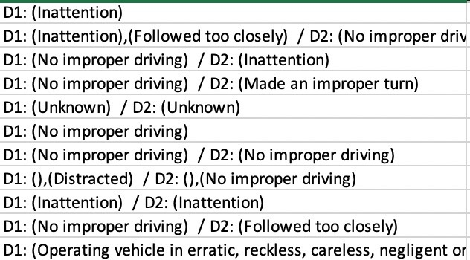
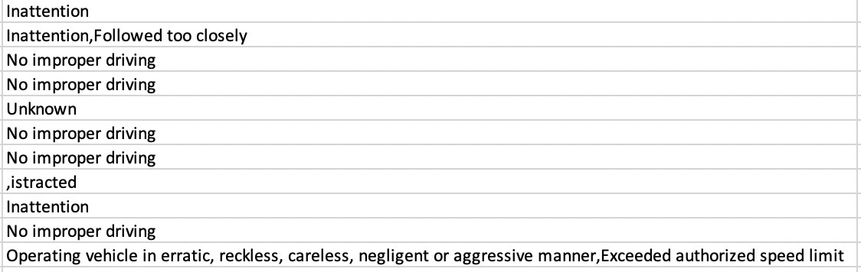
Data Cleaning – to use cleaned data in ML model
Columns not required for the use cases were dropped to increase speed of execution and the size of the full data set is 2.57 GB
Date and Datetime Columns were split to extract year, month, date and hour of day.
Text columns such as DRVR_CNTRB_CIRC_CL (as shown below) were cleaned using regex to extract the first value (D1):

Slide 4
Use Cases
Users can input the zip/county/city/etc.. to search vehicle crashes, our model will show the probabilities of several crash types in that area
System can analyze the data to show the dangerous place to drive in the specific time periods/road surface conditions/ weather, etc..
Users can search for crash records, system will return the records which matched based on location, vehicle type, driver details, crash type.
System runs crash records data (Machine Learning) model and predicts the probability of crash for a given scenario (location/vehicle/driver details).

Slide 5
Searching Crash Records
Implemented a class with primary and auxiliary constructors and passed these constructors to a method to search for crashes
Search user case is implemented using Spark SQL
Users can search crashes based on 5 attributes namely Locality, age, vehicle, weather, and road
Based on search parameters described above, we get the results with the 100% accuracy

Slide 6
Naïve Bayes Model to Predict Fatality
New column FATALITY_BIN was created to store whether a fatality occurred during a crash based on the column NUMB_FATAL_INJR (if number of fatal injuries > 0 then 1 else 0).
FATALITY_BIN is now the target variable of prediction in the Naïve Bayes model.
20 input variables (chosen from 157 variables) were used to predict fatality in a crash. These variables typically contain information on what happened before the crash rather than after.
The accuracy of our Naïve Bayes model is 81%

Slide 7
Naïve Bayes Model Design
Create subset of main dataset with predictors
Clean datetime and driver related activities
Perform string indexing on categorical variables
Split the data into training and testing (train – 66%)
Create an RDD of LabeledPoints to be used as input to the model
Assemble all variables into a vector and a label
Train
Test and get accuracy
Test model on input data

Slide 8
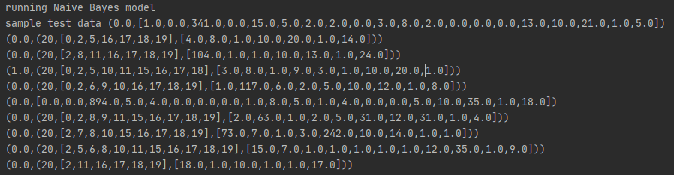
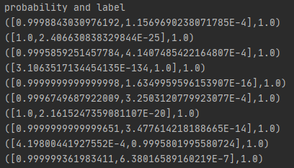
Sample Test Data

Slide 9
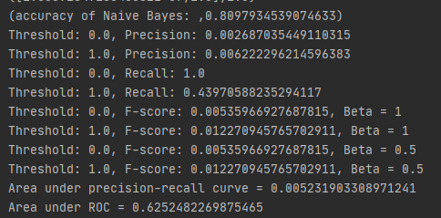
Model Performance
Although accuracy is only at 80.97% the AUC is 0.62probably because the classes are imbalanced; there are way more non-fatalities than fatalities.

Slide 10
Acceptance Criteria
Return results for user query within 5 seconds.
Greater than 80% accuracy when searching for data on crash type/driver information/location, etc..
At least 85% model accuracy for predicting number of crashes
Expected
We did not predict number of crashes instead we predicted the probability of a fatality and we hit 81% test accuracy
Based on the search attributes we defined we hit 100% search accuracy
4 minutes and 40 seconds to search the entire 2.6 GB dataset
Actual

Slide 11
Improvements That Can be Made
The Naïve Bayes model can be improved by selecting better input parameters or the Naïve Bayes model itself can be eschewed in favor of a more complex model such a deep neural network since the data is very large and comprehensive.
Processing the input data could be more efficient as it takes a lot of time to ingest 2.6 GB of data.
Searching can be done using a user interface with more powerful querying options such as time filters, option to switch between exact and wildcard searches.

Slide 12
GitHub Repository
https://github.com/shriramkarthikeyan/CSYE7200_Team_2_Big_Data_Project_MA_Vehichle_Crash_Analysis

Slide 13

Thank you!

